Slide 1
Data Science!

Slide 2
http://aka.ms/bullisday1

Slide 3
“I keep saying the sexy job in the next ten years will be statisticians. People think I'm joking, but who would've guessed that computer engineers would've been the sexy job of the 1990s?” - Hal Varian , Chief Economist at Google

Slide 4
Who
When
What
Where
Why
Notes:
What is data science
Who is a data scientist
Where do data scientists work
Why should you care?
When to use data Science?

Slide 5
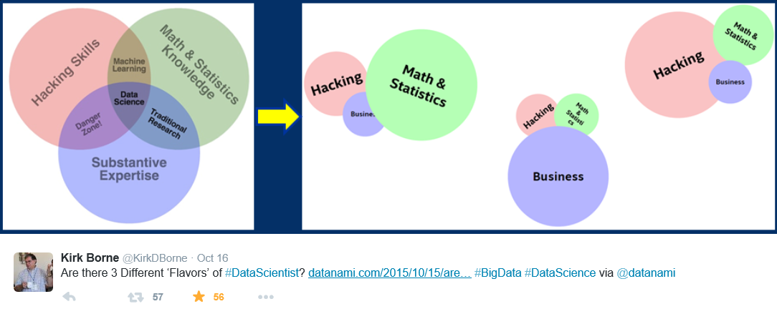
What is data science?

Slide 6
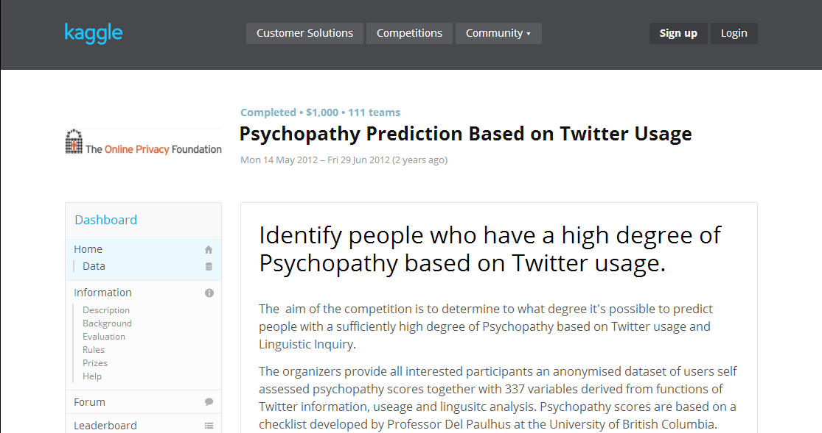
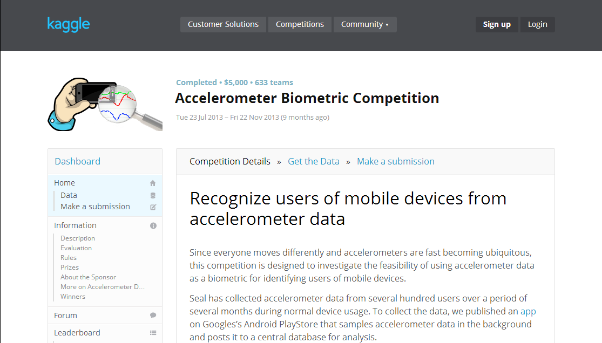
What is data science good for?
Spam detection
Sentiment analysis
Speech recognition
Finding psychos on Twitter (e.g. @jpalioto)
Spying on you
Catching criminals

Slide 7

Catching Criminals
Notes:
- How do you get from this

Slide 8

Catching Criminals
Notes:
- To this

Slide 9
Catching Criminals
Forensic analysis on highly degraded surveillance photos
Traditional approaches will not work
How can it be done with data science and machine learning?
Notes:
Often times, in law enforcement, it’s required to do forensic analysis on highly degraded surveillance photos to gather information
Many scenarios where like the one I just showed you, where the photos are so degraded that traditional approaches won’t yield results
Take surveillance image and estimate the perspective distortion, noise, and blur
Apply estimated values to high res photos, and do a cross correlation between manually degraded hi res photos and the actual photo
ML -- Apply a multi-class support vector machine learning algorithm to identify how particular distorted letters look when they are blended on the left and the right with other distorted letters
For instance, train the classifier to recognize a distorted ‘e’, with surrounded by ‘a’ and ‘b’ versus ‘c’ and ‘d’
And this can be used in forensic analysis to produce evidence that would not have normally been available by other means

Slide 10

Math
Science
Notes:
Arrows merging Computers and Statistics

Slide 11
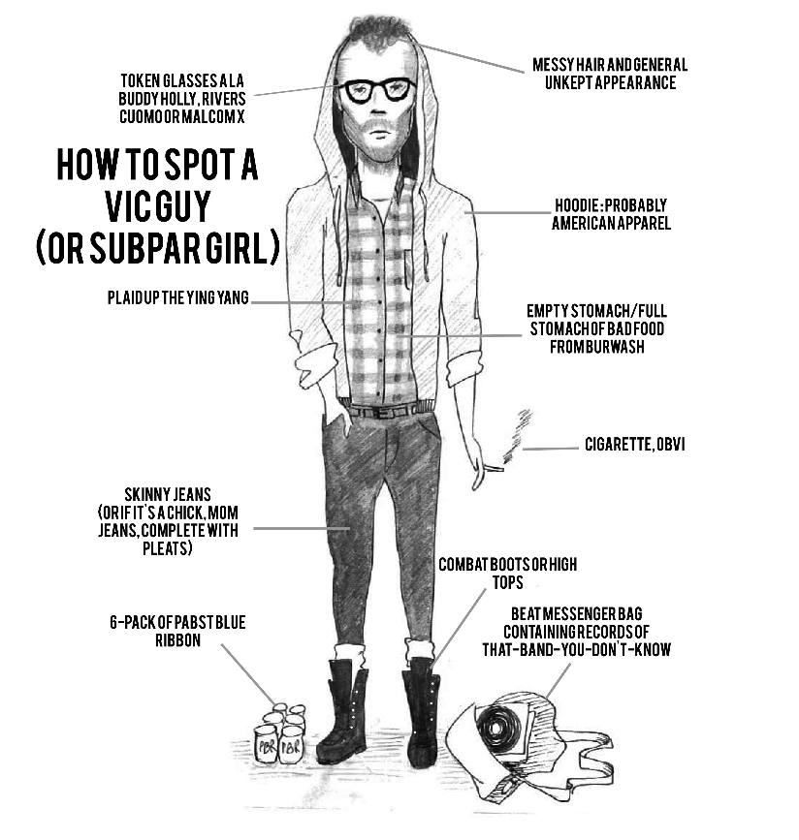
Who is a Data Scientist?
Data Scientist
Notes:
https://headsink.files.wordpress.com/2012/03/hipster.jpg

Slide 12

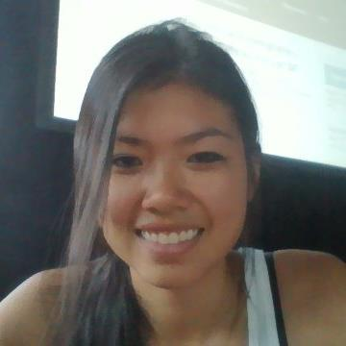
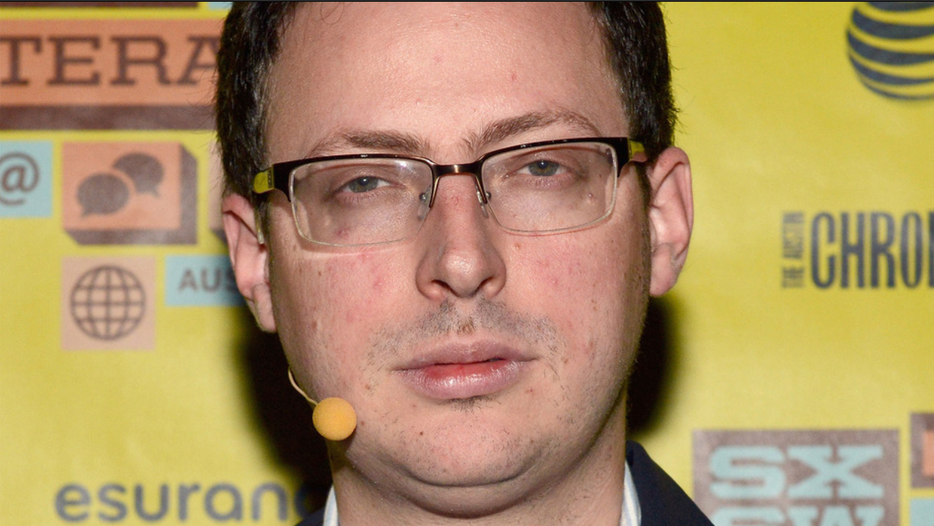

Slide 13
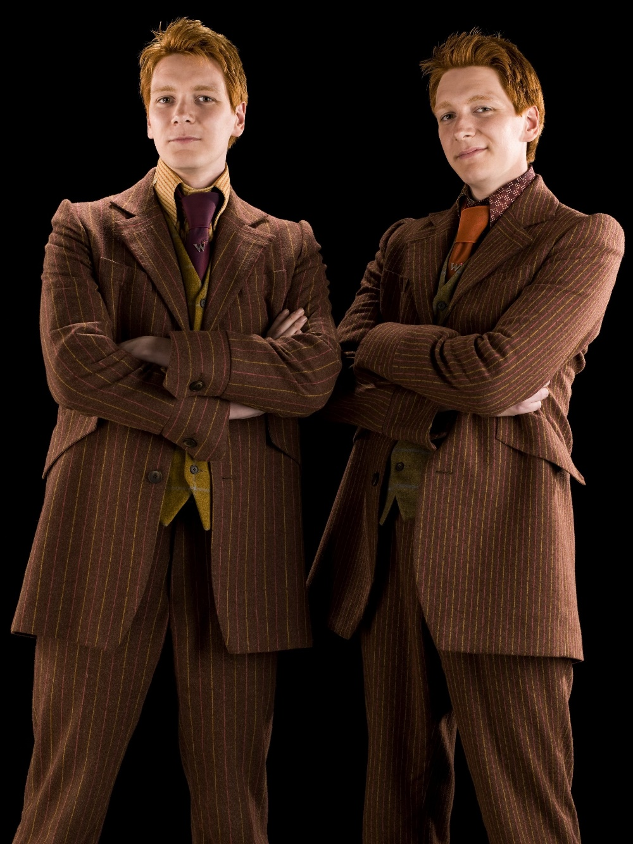
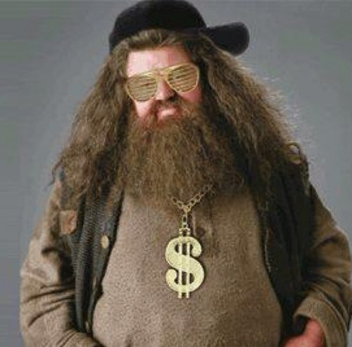

Notes:
Who it takes to be an amazing team for business?
Hermione- Data Scientist
Hagrid – Developer
Harry- Ceo
Nevelle –
Ron -Sales

Slide 14


Slide 15




Where do data scientists work?

Slide 16
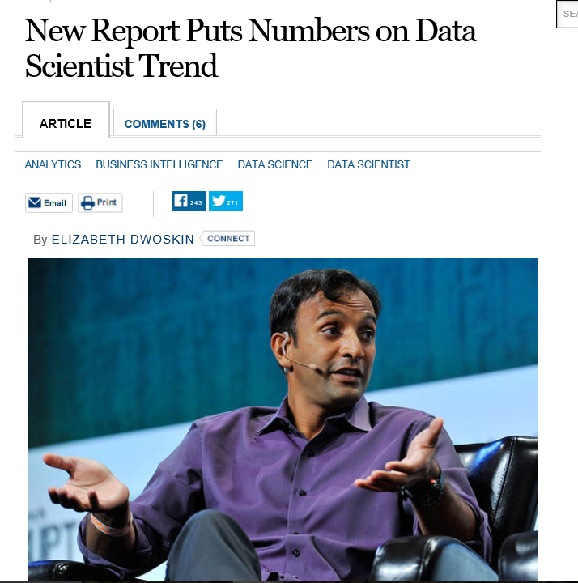
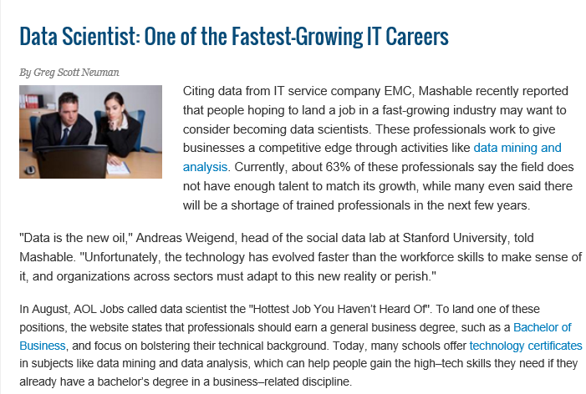
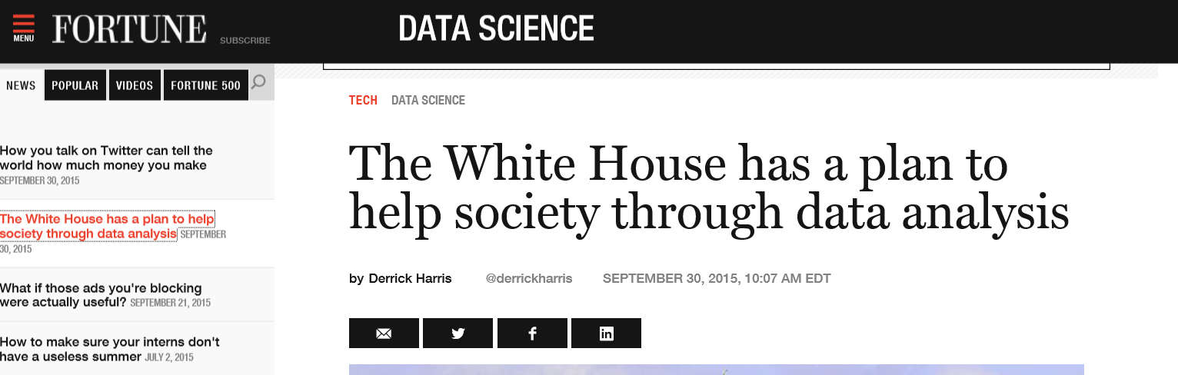
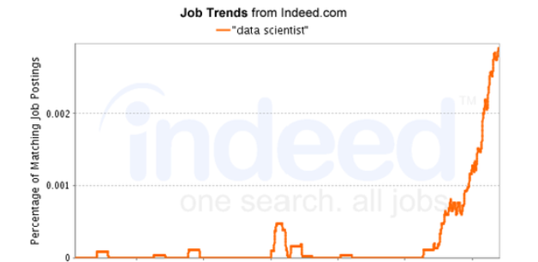
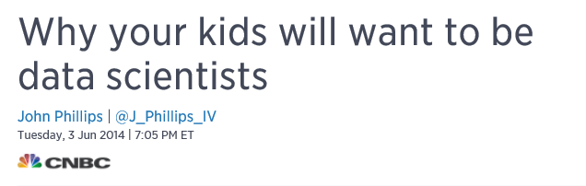
Why should you be interested?

Slide 17
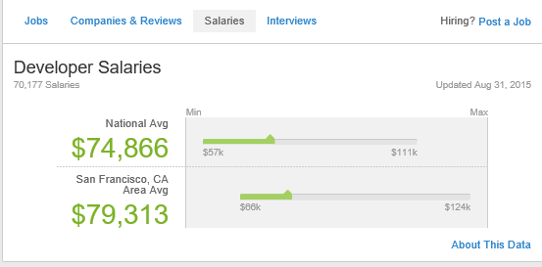
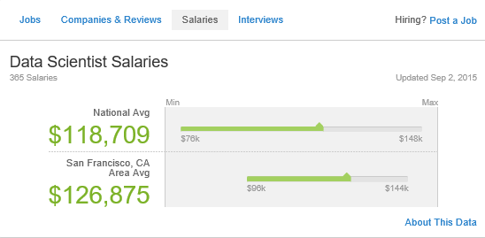

Slide 18
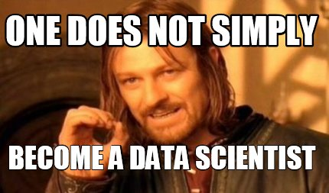

Slide 19
When to use data science?
Predicting outcome of a lottery?
Machine Learning does not work well on predicting something that is inherently random.
No Pattern No ML

Slide 20
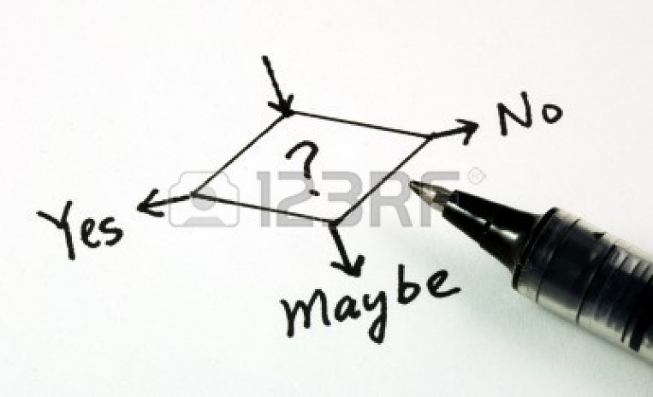

Problem Requirements
Valuable business problem involving decision
Existing process
Metrics
Available data
Related to the decision
Historical
Outcomes
Notes:
http://us.123rf.com/400wm/400/400/johnkwan/johnkwan1008/johnkwan100800099/7596302-yes-no-or-maybe-concepts-of-making-business-decision.jpg

Slide 21

Data tells us a story

Slide 22
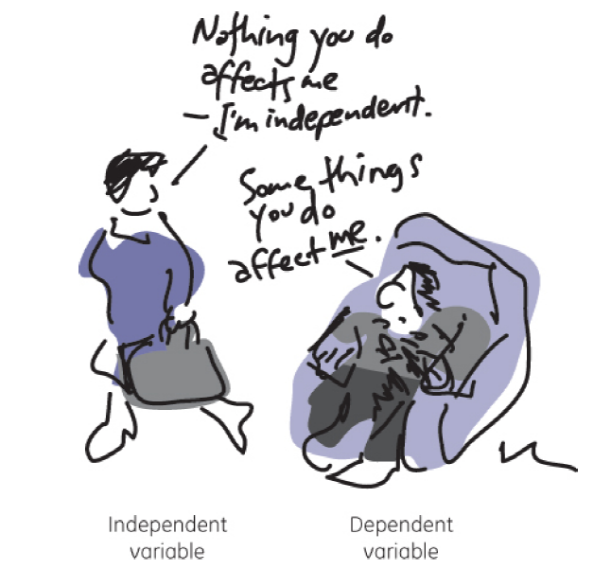

Slide 23
Would you have survived the Titanic?
Class | Name | Age | Ticket # | Fare | Cabin # | Survived
First | Carl A | 25 | 1 | A | 123 | 0
Main | Steven S | 55 | 2 | C | 324 | 1
Dependent Variable
Independent
Variable
…
…
…
…
…
Features

Slide 24




Probability
The Number Of Ways Event A Can Occur
The total number Of Possible Outcomes
P(A) =
Notes:
Pizza example

Slide 25
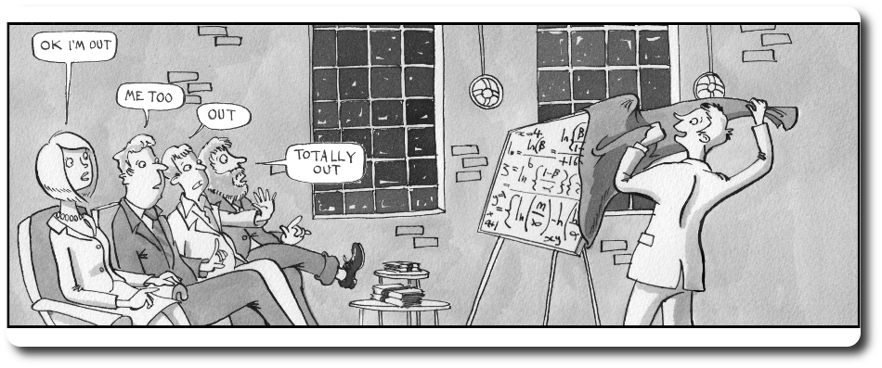
Is this happening to you?

Slide 26
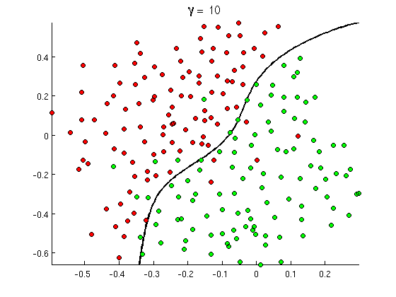
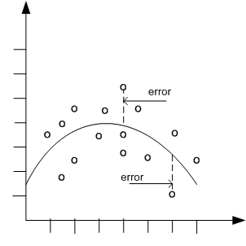

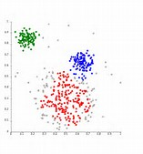
Common Classes of Problems
Classification
Regression
Recommenders
Clustering
Notes:
http://openclassroom.stanford.edu/MainFolder/courses/MachineLearning/exercises/ex8materials/ex8b_10.png
http://docs.oracle.com/cd/B28359_01/datamine.111/b28129/img/scatter_plot_nonlinear.gif
http://spectrum.ieee.org/img/RecommendNEWf1-1348253703748.jpg
Hogwarts

Slide 27



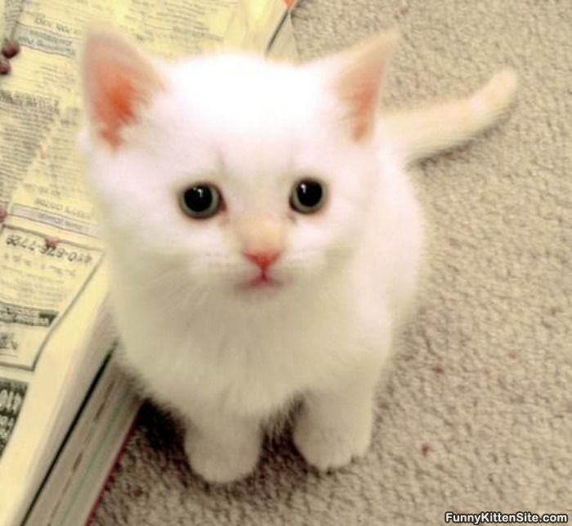


Classification
Think categories
Example: Cat or Dog?

Slide 28
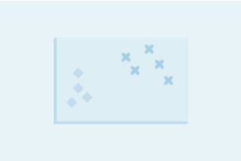
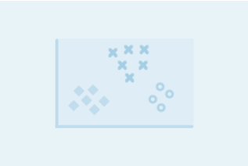
Binary vs. Multiclass Classification
Binary examples
Is that email spam or not spam?
Is that person on Twitter a psycho?
Multiclass examples
What kind of flower is that?
Which Hogwarts house do I belong in?

Slide 29
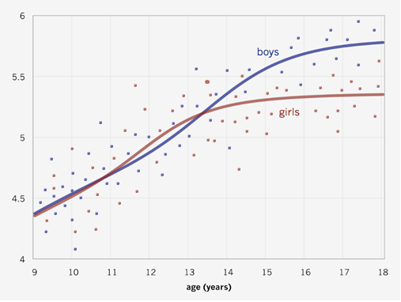
Regression
Predicting a numerical value
Example: How old are you based on your height?
height (ft)

Slide 30
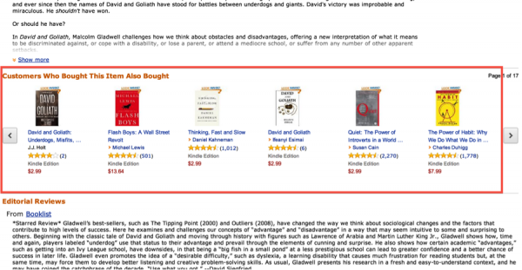
Recommenders
Suggestions based on things you like

Slide 31
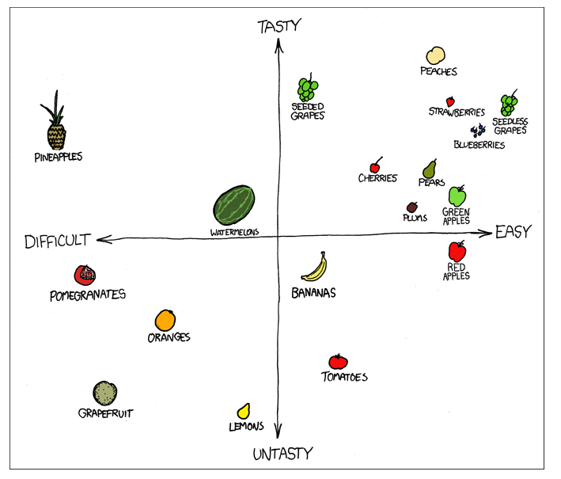
Clustering
Grouping similar things

Slide 32
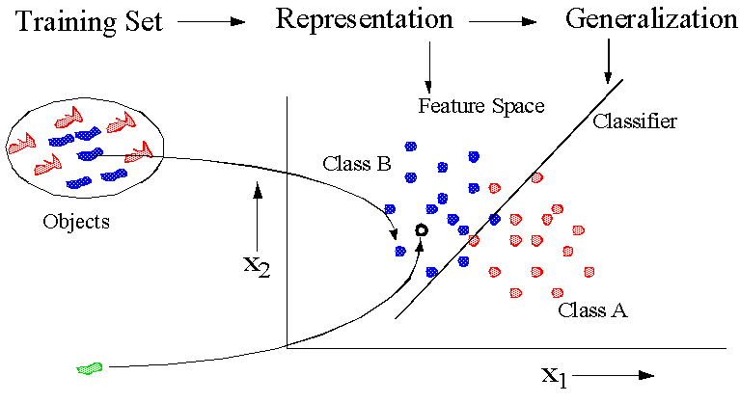
Learning From Data
Source: http://prlab.tudelft.nl/content/pattern-recognition
Notes:
Basic concept of pattern recognition

Slide 33
What makes for a good ML problem?
Labeled examples
Spam detection: examples of spam email and regular email
Twitter crazies: examples of psychos on twitter vs. other people
Relevant features
Email information: subject line, sender email address, words in email
Twitter user information: age, gender, how often he/she tweets, words and phrases used in tweets
Uncertainty/error tolerance
Finding some junk mail is better than missing important email
Automated psycho identification still verified by human

Slide 34
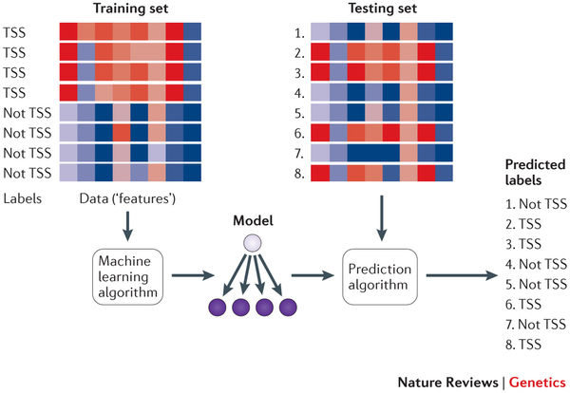
Machine Learning Problems in Genome Sciences
Predicting gene expression based on sequence
Predicting where genes are and what they do
Predicting disease biomarkers

Slide 36
http://aka.ms/bullisclasssurvey

Slide 38
the fastest possible intro to machine learning

Slide 39
Machine Learning develops and uses algorithms
to make predictions from data

Slide 40
algorithms
algorithms
Machine Learning develops and uses algorithms
to make predictions from data
predictions
predictions
data
data

Slide 41
Machine Learning develops and uses algorithms
to make predictions from data

Slide 42
algorithms
Machine Learning develops and uses algorithms
to make predictions from data
predictions
data

Slide 43
algorithms
predictions
data

Slide 44
data
predictions
algorithms

Slide 45
data
Think data in a spreadsheet
Age | Occupation | Gender | Hours/Week | Income
35 | Farming-fishing | Male | 40 | <=50K
23 | Adm-clerical | Female | 30 | <=50K
31 | Sales | Male | 38 | >50K
31 | Prof-specialty | Female | 50 | >50K
Rows are “Data points” (person, for example)
Columns represent “Features”
The set of features for a data point is a “Feature Vector”
Notes:
TO DO: add their data and ask them what predictions can we make from this data
-they should come up with the questions they should ask of the data, which of the four types of problems it is, and tell us a feature that is relevant (or multiple)

Slide 46
data
Think data in a spreadsheet
Age | Occupation | Gender | Hours/Week | Income
35 | Farming-fishing | Male | 40 | <=50K
23 | Adm-clerical | Female | 30 | <=50K
31 | Sales | Male | 38 | >50K
31 | Prof-specialty | Female | 50 | >50K
Rows are “Data points” (person, for example)
Columns represent “Features”
The set of features for a data point is a “Feature Vector”
You may have hundreds of millions of Data Points
You may have many features
Two data sets: training and test
Training data set has the answers labeled
Test data set has known answers but is unmarked
Age | Occupation | Gender | Hours/Week | Income
28 | Adm-clerical | Male | 32 | <=50K
32 | Tech-support | Female | 30 | <=50K
31 | Sales | Female | 38 | >50K
49 | Exec-management | Male | 60 | >50K

Slide 47
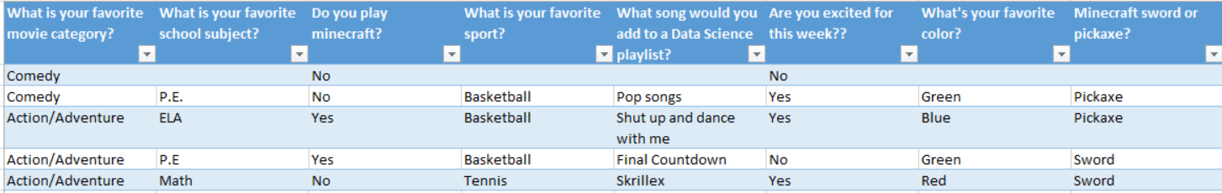
data:features
Features turn a “thing” into a vector
Features are designed specifically for a dataset and desired prediction
Much of the magic of ML is choosing the right feature vectors

Slide 48
prediction
Think generalization, not telling the future
Use a training set to generalize
Use generalizations to perform accurately on new, unseen examples

Slide 49
algorithm
Think about the process
Precise set of rules/ instructions
You already have algorithms in your daily life!
In computer science, an algorithm is a precise set of steps for a computer program to perform a task
What makes a good algorithm?
Notes:
You might have an algorithm for getting reading in the morning, or for making the perfect grilled cheese sandwich.
It’s a set of steps to accomplish a task.
Computer science is all about finding good algorithms and knowing when to apply them.
Some famous algorithms: The way google hangouts is able to transmit live video across the internet so quickly. They use audio and video compression algorithms. How google maps figures out how to get from UW to the Space needle. That’s a route finding algorithm. Pixar uses a rendering algorithm to color 3D characters based on the lighting in a virtual room. How does Nasa choose how to arrange the solar panels on the International Space station and when to rearrange them> That’s an optimization and scheduling algorithm.
These algorithms are more complex than our daily algorithms, but they’re still a set of precise instructions to accomplish a task.
What makes a good algorithm? It should solve the problem and it should do so efficiently. We don’t want something that solves the problem but does so really slowly. Also, we don’t want something that gives us the wrong answer.
Luckily for us, there are already a lot of algorithms that have been built for machine learning already.

Slide 50

Data Set
Clean Up
the general process
Split
Training Algorithm
You have a dataset
Clean up your dataset
Separate dataset into training data and test data
Choose an algorithm
Train your algorithm with the training data
Test your algorithm on your test data
Analyze results
Wash rinse repeat
Training Data Set
Test
Data Set
Score
Evaluate
Notes:
Dataset: everyone in room stands up
Clean up: remove non-students
Split: 15/rest
Training: group by favorite subject; tell them to find what type of movie was most popular in their groups

Slide 51
Data Set
Clean Up
the general process: your turn!
Split
Training Algorithm
You have a dataset
Clean up your dataset
Separate dataset into training data and test data
Choose an algorithm
Train your algorithm with the training data
Test your algorithm on your test data
Analyze results
Wash rinse repeat
Training Data Set
Test
Data Set
Score
Evaluate
Notes:
Dataset: everyone in room stands up
Clean up: remove non-students
Split: 15/rest
Training: group by favorite subject; tell them to find what type of movie was most popular in their groups

